Slide 1

Team Epox
Day 3 mentoring session

Slide 2
Made with Free and Open Source Software
Our solution purely relies Free Software such as
React.js - Facebook
Flutter – Google
Firebase (free tier) – Google
Co-laboratory (with GPU) – Google
Google Cloud Platform (free tier)
YOLOv5 Algorithm (fine-tuned to our needs)
Various Open source Python libraries like FLASK, OpenCV, Pillow, NumPy etc

Slide 3
But how much would it cost in practice?
In the actual implementation of our solution, the only cost the Government will have to Incur would be the Server Costs
A rough estimate of the server cost to accommodate a user-base of 1 Million active monthly users is done below
Technology | Usage | Cost
AWS or GCP servers | For hosting the deep learning model and the website | ₹ 580 (approximately) (After the first free year)
Nvidia Tesla T4 GPU | For training bigger YOLOv5x model for ~2 days | ₹ 1260 (approximately) (one-time investment)
Firestore | For storing the user submissions and user details | ₹4500* (safe approximation)
 | Total | ₹1260 (one time) + ₹5100 (rounded off)
*safe estimate by considering uploaded image with average size as 4 MB and 6500 GB worth of image upload on yearly

Slide 4
Literature Survey
Development of Overall Pavement Condition Index for Urban Road Network (2013) (Yogesh U. Shah, S.S. Jain, Devesh Tiwari, M.K. Jain)
Deep Machine Learning Approach to Develop a New Asphalt Pavement Condition Index (Hamed Majidifard , Yaw Adu-Gyamfi , William G. Buttlar)
The Road Pavement Condition Index (PCI) Evaluation and Maintenance: A Case Study of Yemen (Prof. Dr Fareed M.A. Karim,* Dr Khaled Abdul Haleem Rubasi, and Dr Ali Abdo Saleh. )
Development of PCI-based Pavement Performance Model for Management of Road Infrastructure System _{(Kan Wu)}
Crack-pot: Autonomous Road Crack and Pothole Detection (Sukhad Anand, Saksham Gupta, Vaibhav Darbari, Shivam Kohli)

Slide 5
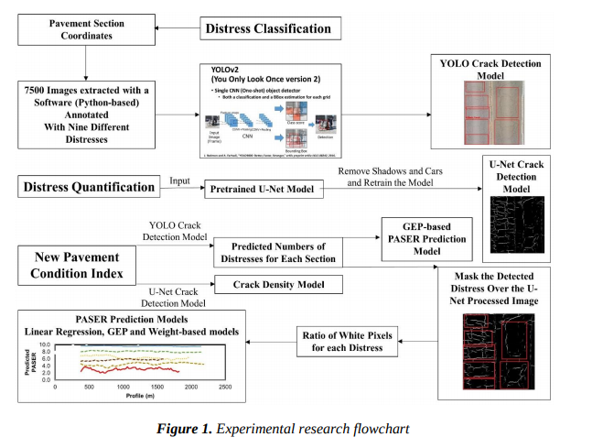
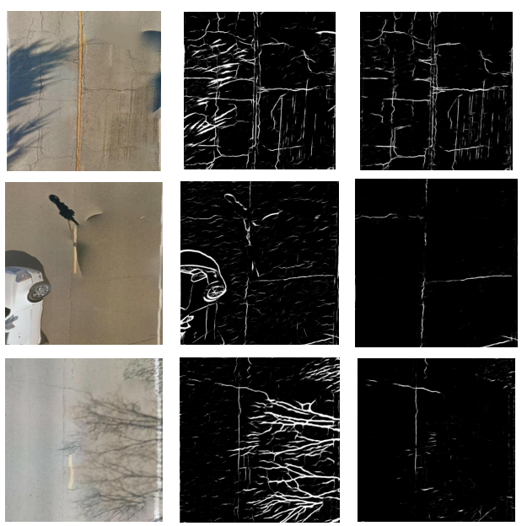
Literature Survey
Deep Machine Learning Approach to Develop a New Asphalt Pavement Condition Index
Authors : Hamed Majidifard , Yaw Adu-Gyamfi , William G. Buttlar
Grey scale images as output
2 models used (YOLOv2 & U-Net)
Src: Deep Machine Learning Approach to Develop a New Asphalt Pavement Condition Index

Slide 6
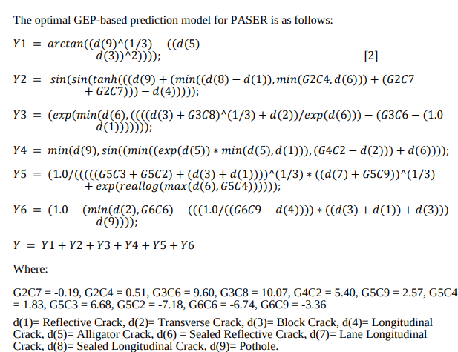
Literature Survey
Deep Machine Learning Approach to Develop a New Asphalt Pavement Condition Index
Authors : Hamed Majidifard , Yaw Adu-Gyamfi , William G. Buttlar
PCI calculation methodology extremely complex with too many factors
More labourious to label images for segmentation task
No scope of making it model independent
Grey scale plays an important part to PCI calculation but is a highly volatile metric to base PCI on.
Src: Deep Machine Learning Approach to Develop a New Asphalt Pavement Condition Index

Slide 7
Literature Survey
Development of Overall Pavement Condition Index for Urban Road Network
Authors : Yogesh U. Shah, S.S. Jain, Devesh Tiwari, M.K. Jain
Published by Elsevier Ltd
2nd Conference of Transportation Research Group of India
Selection and peer-review under responsibility of International Scientific Committee
This paper is the bedrock of our PCI formulation and calculation
Edifice of the M-R impact
The study area consists of 10 road sections constituting 29.92 km of Noida city.

Slide 8
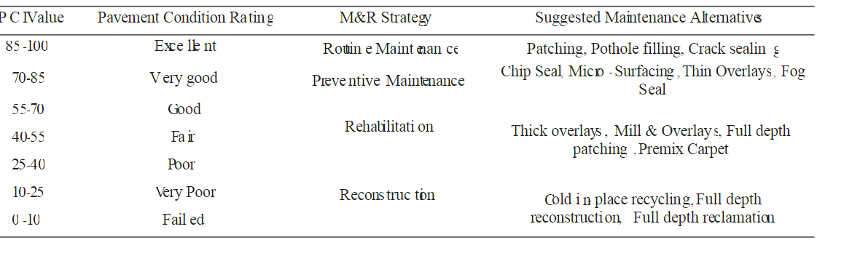
Exploration of M&R
Literature Survey
M&R Strategies based on PCI values
BUILD-MEASURE-LEARN PROCESS
Cited from Development of Overall Pavement Condition Index for Urban Road Network

Slide 9
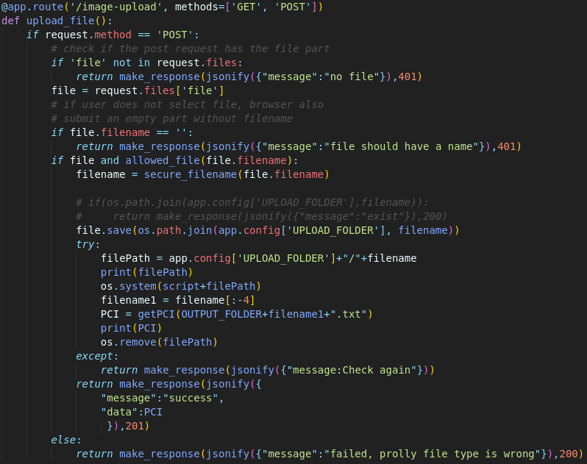
Progress Report
Wrote the final python script last night
Complete integration of our mobile application, Computer vision model and government admin panel
Have also restructured the app code

Slide 10
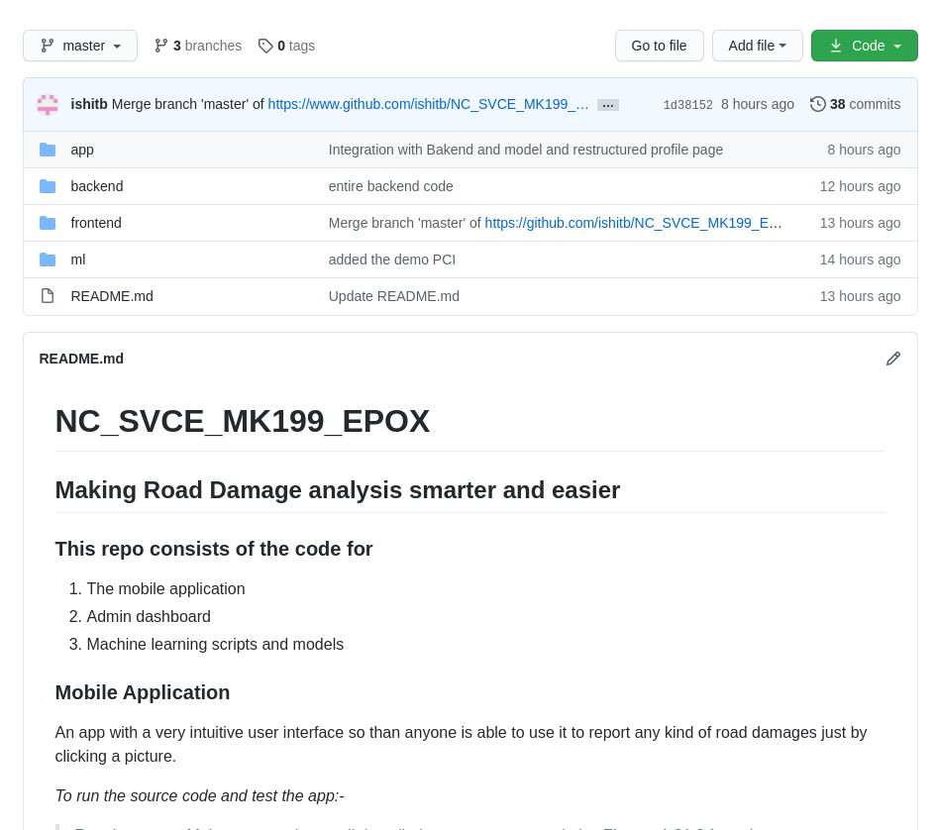
Progress Report
We are now preparing the demo for the final round of evaluation
Ensuring that we have uploaded all the code to GitHub

Slide 11
Questions ?

